Slide 1



Home
About
Solution
Apporach Details
TEAM - 5

Slide 2

Home
About
Solution
Apporach Details
TEAM AND PROBLEM STATEMENT
Team Name : Team 5
Problem Statement ID : SIH1329
Problem Statement : The project addresses the need for a 360-degree feedback software for monitoring Government of India-related news stories in regional media using Artificial Intelligence and Machine Learning.

Slide 3

ABSTRACT :
Home
About
Solution
Apporach Details
Home
About
Solution
Apporach Details
In today's fast-paced digital landscape, real-time media monitoring is crucial for effective governance and public communication. This project introduces an AI-driven 360-degree feedback system to track Government of India-related news across regional media. Using Artificial Intelligence (AI) and Machine Learning (ML), the system scrapes news articles and scans e-papers using Optical Character Recognition (OCR). It also processes YouTube news bulletins to extract relevant content. This ensures comprehensive media coverage and timely insights.
To enhance analysis, the system employs Natural Language Processing (NLP) to classify news based on government departments. It also performs sentiment analysis to categorize news as Positive, Neutral, or Negative. When negative news is detected, real-time alerts are sent to officials for immediate action. This enables proactive decision-making and better crisis management. Automated tracking helps in identifying key trends and emerging issues.
A user-friendly dashboard with multilingual support allows officials to filter and analyze reports efficiently. This platform streamlines media monitoring, reducing manual effort and response time. By automating news tracking, classification, and sentiment analysis, the system improves government decision-making. It also aids in managing public perception and strengthening policy communication. Ultimately, this technology-driven approach enhances governance and transparency.

Slide 4
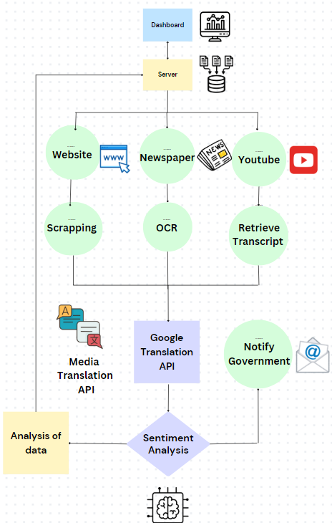
SOLUTION :
Home
About
Solution
Apporach Details
Automated Data Collection:
Develops a system to scrape news articles and videos from multiple sources, including websites, e-newspapers, and YouTube channels.
Extracted data is processed to identify key details like headline, content, publication date, and source URL.
01
Categorization and Sentiment Analysis:
Classifies articles based on the ministry’s jurisdiction using an accurate machine learning model.
Performs sentiment analysis (Positive, Neutral, or Negative) for actionable insights.
02
Real-Time Alerts and Notifications:
Sends alerts for negative news articles to respective government departments via email for immediate response.
Provides timely updates on critical news events.
03
04
User-Friendly Interface:
Displays news on a simple and intuitive dashboard that supports multiple languages (English, Hindi, and regional languages).
Offers features like manual refresh, automatic hourly updates, and easy filtering by sentiment and ministry.

Slide 5






Approach details :
Home
About
Solution
Apporach Details
Crawled 12000+ news articles and videos using Python Beautiful Soup and Selenium Library.
Applied clustering on these articles to label them into different categories to prepare labeled dataset.
Trained this dataset of articles using BERT model to generate department predictions.
implemented sentiment analysis on news articles.
Sending mail of Negative News to respective departments using NodeMailer and Gmail - SMTP
Integrated this model and crawling functionality with a Django backend and wrote APIs for generating predictions and sentiments.
Merged this backend with a simple and attractive UI where user can give triggers to load latest news articles with their analysis.
Implemented video news analysis using Selenium library by first extracting audio and converting it into text. Then applied classification and sentiment analysis on the extracted text.
Developed the same functionalities for news in Telugu, Hindi and others languages as well using Google Translate API.
Technology Stack :
AI: PyTorch, TensorFlow, and BERT libraries for creating ML models.
Crawling: Beautiful Soup, Selenium
Server: Django backend.
Frontend: HTML , CSS,
JavaScript .

Slide 6
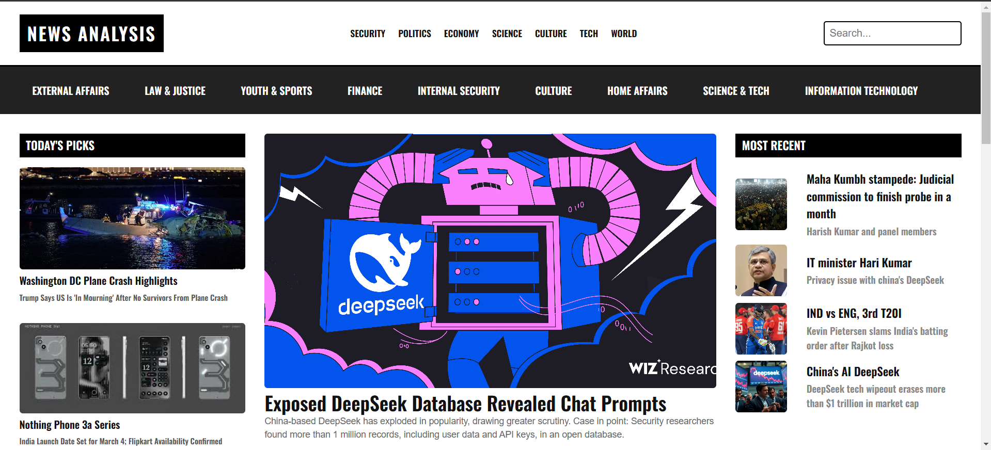
HOME PAGE:
Home
About
Solution
Apporach Details

Slide 7
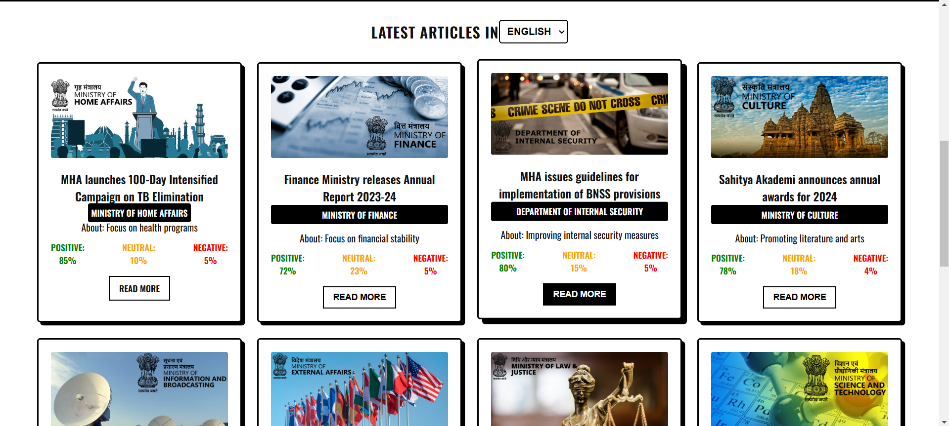
SENTIMENT ANALYSIS
Home
About
Solution
Apporach Details

Slide 8
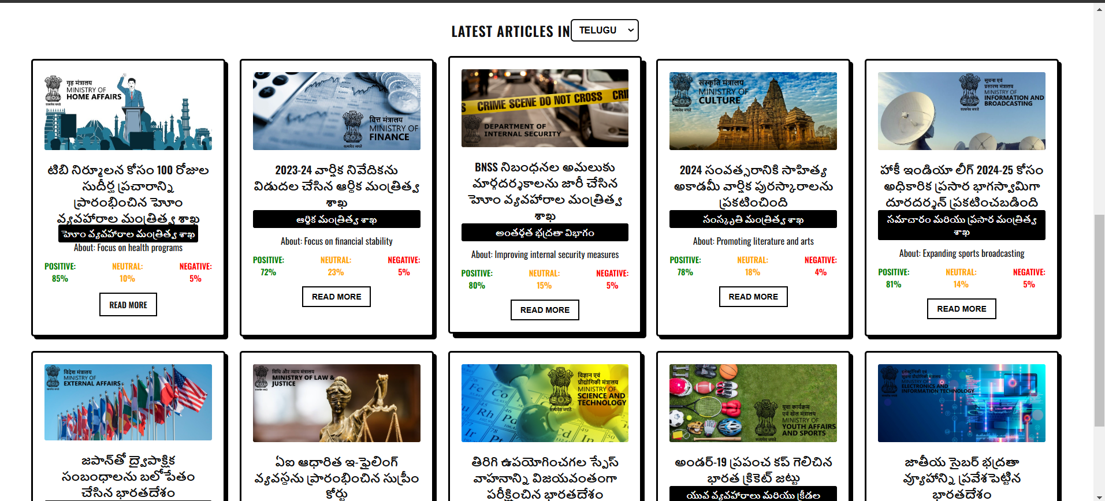
MULTI LANGUAGE:
Home
About
Solution
Apporach Details

Slide 9
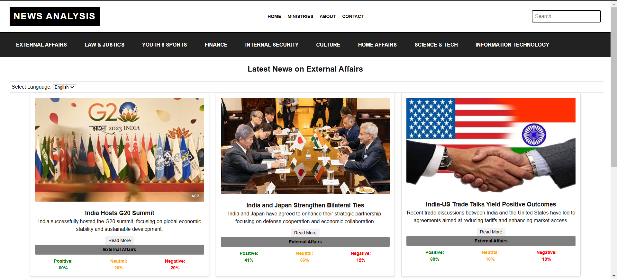
INDIVIDUAL MINISTRY
Home
About
Solution
Apporach Details

Slide 10
Team Member Details
Home
About
Solution
Apporach Details
Team Leader Name: Harsha Vardhan
Branch : B.Tech
Stream : AIML
Year : III
Team Member 1 Name: Badugu Ajay
Branch : B.Tech
Team Member 2 Name: Hima Padmavathi
Branch : B.Tech
Team Member 3 Name: Hari Kumar
Branch : B.Tech
Stream : AIML
Year : III
Stream : AIML
Year : III
Stream : AIML
Year : III

